Slide 1

Major Project -II(CA401P) Even Semester Session 2025-26 “MuseCrafts” Ayush Saini (202410116100046) Ashish Yadav (202410116100041) Anubhav Vaish(202410116100037) Session:2025-2026 (IV Semester) Under the supervision of Mr. Roshan Kumar Gupta, Mrs. Anita Yadav Department Of Computer Applications KIET GROUP OF INSTITUTIONS, DELHI-NCR, GHAZIABAD-201206

Slide 2
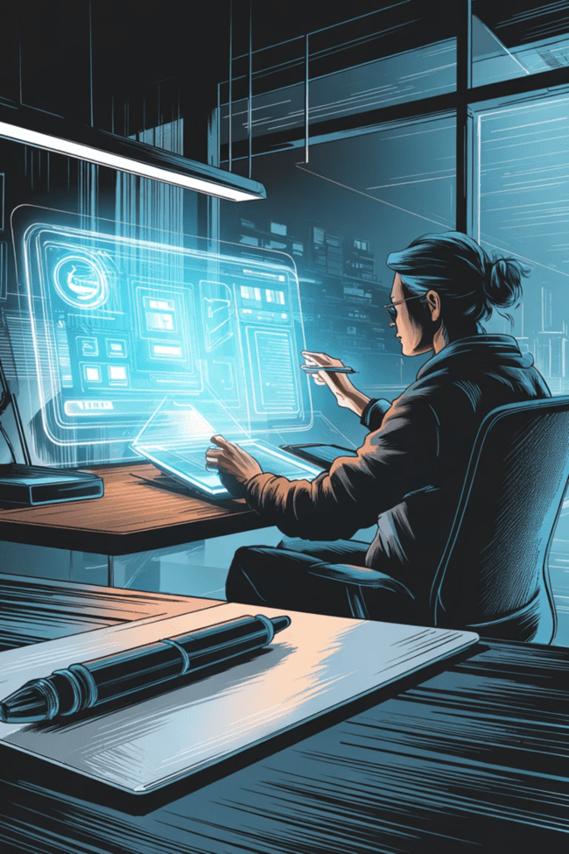
MuseCraft System Design
A Creative Digital Platform with System Architecture
Presented by: Ayush Saini

Slide 3
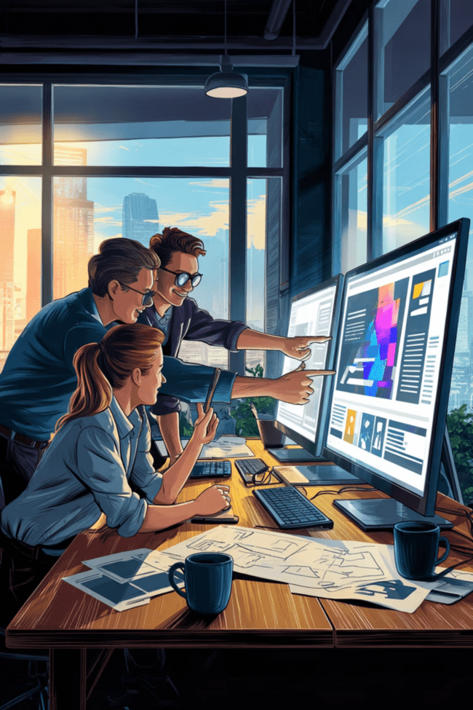
What is MuseCraft?
Digital Creative Platform
Integrated Workflow
Combines user interaction with system automation for efficiency
Tools for artists and designers to create, edit, and publish content
Collaboration Focus
Streamlined processes for team-based creative projects

Slide 4
Problem Statement
Fragmented Tools
Management Challenges
Creators use multiple tools with no integration between platforms
Difficult to manage projects and coordinate collaboration effectively
No Central Hub
Manual Processes
Absence of centralized system for creation and sharing workflows
Time-consuming manual work slows down creative output

Slide 5
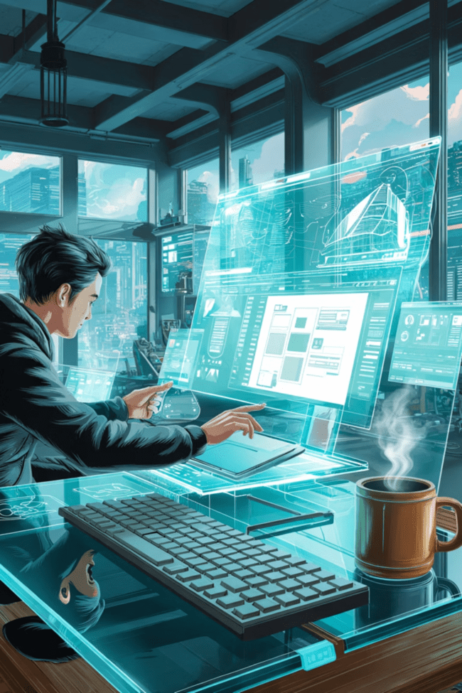
Proposed Solution
MuseCraft Platform
All-in-One Platform
Complete solution for creative work from concept to delivery
Integrated System
Design, management, and sharing combined in single interface
AI-Assisted Tools
Intelligent features accelerate creation and editing processes
Cloud Storage
Accessible from anywhere with secure data management

Slide 6
System Modules
01
02
03
User Management
Project Creation
Content Editing
Secure login and signup functionality
Initialize and organize creative projects
Comprehensive tools for design work
04
05
Collaboration
Publishing & Sharing
Team-based features for real-time work
Final output distribution system

Slide 7

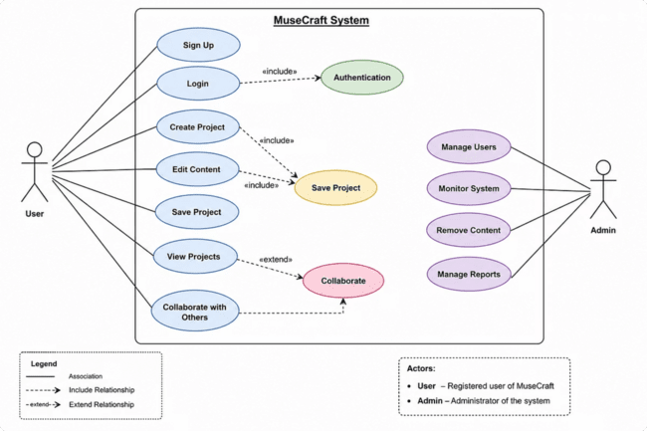
Use Case Diagram
User Actions
Admin Actions
Create projects
Edit content
Share work
Manage users
Monitor system
Shows interaction between users and system components

Slide 8

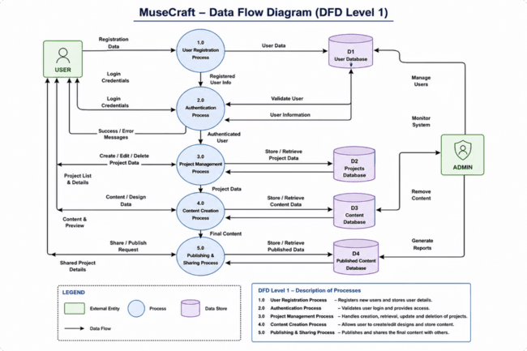

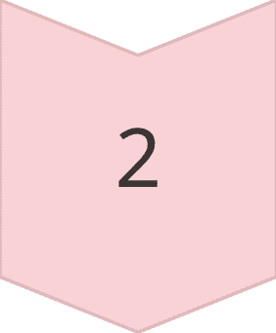
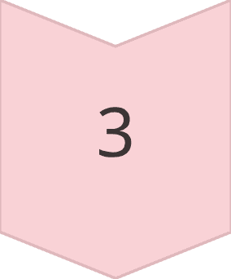
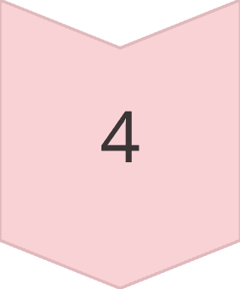
Data Flow Diagram
Input
User data and project information
Processes
Authentication, creation, storage
Output
Final content and shared projects
Storage
User and project databases

Slide 9

System Working
User Authentication
Secure login into system
Project Selection
Create new or select existing project
Content Creation
Design and edit using platform tools
Data Storage
Save work to database automatically
Sharing
Publish final output to audience

Slide 10
Advantages & Limitations
Advantages
Limitations
Centralized platform
Easy collaboration
Time-saving automation
Internet dependency
Performance varies by system
Advanced features may require subscription

Slide 11

Conclusion & Future Scope
MuseCraft improves creative workflow by combining design + management + sharing in one platform.
Future Enhancements
Advanced AI Tools
Mobile Integration
More intelligent creation features
On-the-go creative capabilities
Real-Time Collaboration
Enhanced team coordination

